Slide 1
Computer Organization and Architecture
Instruction Pipelining

Slide 2
Pipelining
Fetch instruction
Decode instruction
Calculate operands (i.e. EAs)
Fetch operands
Execute instructions
Write result
Overlap these operations
Notes:
38

Slide 3
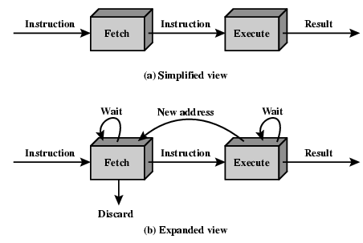
Two Stage Instruction Pipeline

Slide 4
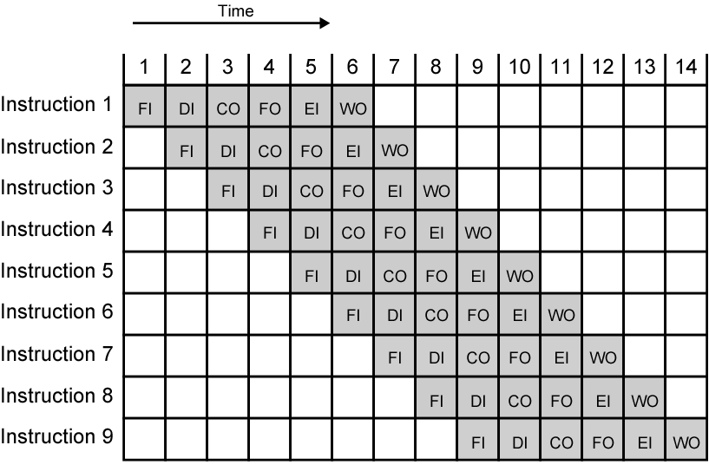
Timing Diagram for
Instruction Pipeline Operation
Notes:
39

Slide 5
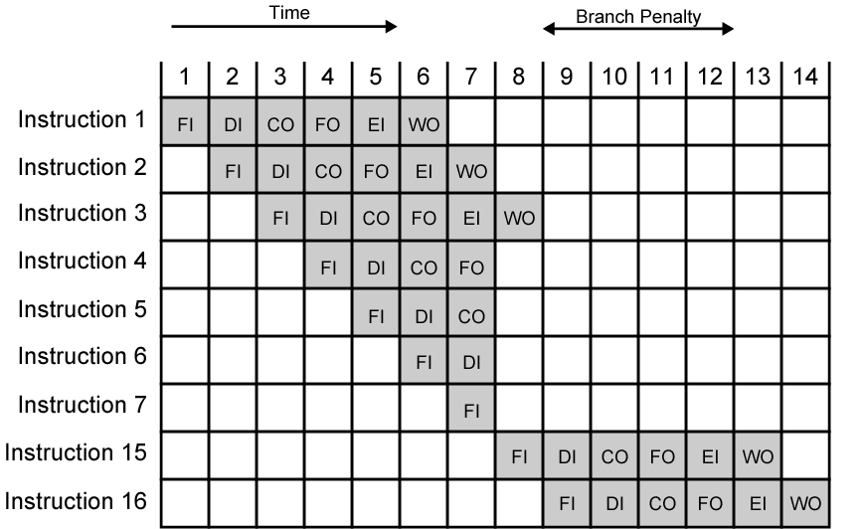
The Effect of a Conditional Branch on Instruction Pipeline Operation
Notes:
40

Slide 6
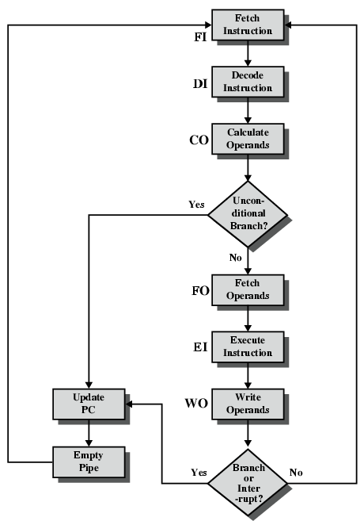
Six Stage
Instruction Pipeline

Slide 7
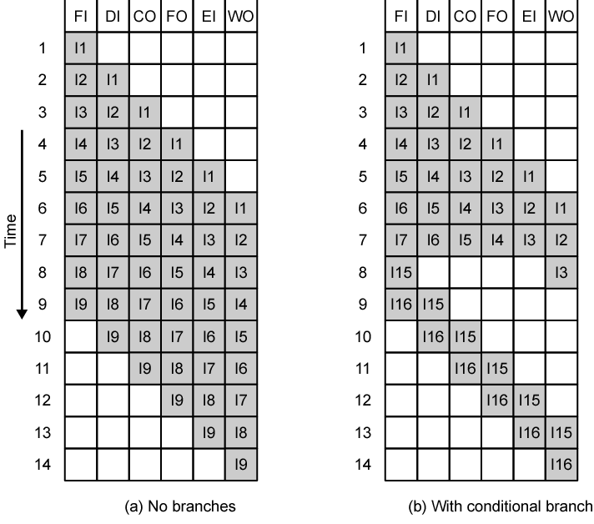
Alternative Pipeline Depiction

Slide 8
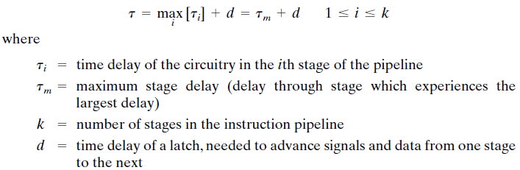
Pipeline Performance
The cycle time of an instruction pipeline is the time needed to advance a set of instructions one stage through the pipeline
The cycle time can be determined as

Slide 9

Pipeline Performance(2)
Now suppose that n instructions are processed, with no branches. Let be the total time required for a pipeline with k stages to execute n instructions. Then
The speedup factor for the instruction pipeline compared to execution without the pipeline is defined as

Slide 10
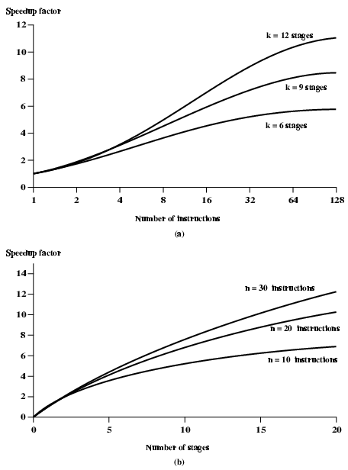
Speedup Factors with Instruction
Pipelining

Slide 11
Pipeline Hazards
Pipeline, or some portion of pipeline, must stall
Also called pipeline bubble
Types of hazards
  Resource
  Data
  Control

Slide 12
Resource Hazards
Two (or more) instructions in pipeline need same resource
Executed in serial rather than parallel for part of pipeline
Also called structural hazard
E.g. Assume simplified five-stage pipeline
  Each stage takes one clock cycle
Ideal case is new instruction enters pipeline each clock cycle
Assume main memory has single port
Assume instruction fetches and data reads and writes performed one at a time
Ignore the cache
Operand read or write cannot be performed in parallel with instruction fetch
Fetch instruction stage must idle for one cycle fetching I3
E.g. multiple instructions ready to enter execute instruction phase
Single ALU
One solution: increase available resources
  Multiple main memory ports
  Multiple ALUs

Slide 13
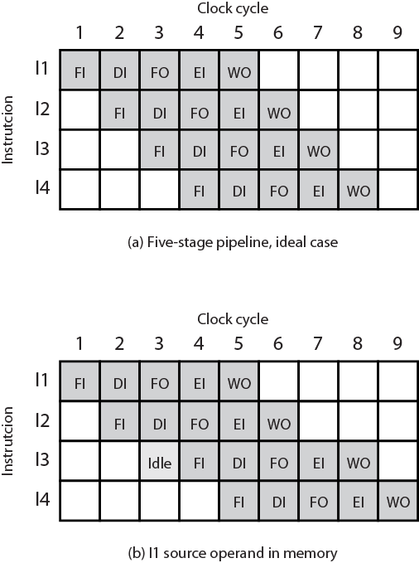
Resource Hazard Diagram

Slide 14
Data Hazards
Conflict in access of an operand location
Two instructions to be executed in sequence
Both access a particular memory or register operand
If in strict sequence, no problem occurs
If in a pipeline, operand value could be updated so as to produce different result from strict sequential execution
E.g. x86 machine instruction sequence:
ADD EAX, EBX /* EAX = EAX + EBX
SUB ECX, EAX /* ECX = ECX – EAX
ADD instruction does not update EAX until end of stage 5, at clock cycle 5
SUB instruction needs value at beginning of its stage 2, at clock cycle 4
Pipeline must stall for two clocks cycles
Without special hardware and specific avoidance algorithms, results in inefficient pipeline usage

Slide 15
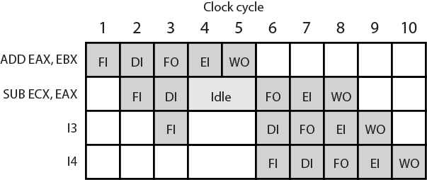
Data Hazard Diagram

Slide 16
Types of Data Hazard
Read after write (RAW), or true dependency
  An instruction modifies a register or memory location
  Succeeding instruction reads data in that location
  Hazard if read takes place before write complete
Write after read (WAR), or antidependency
  An instruction reads a register or memory location
  Succeeding instruction writes to location
  Hazard if write completes before read takes place
Write after write (WAW), or output dependency
  Two instructions both write to same location
  Hazard if writes take place in reverse of order intended sequence
Previous example is RAW hazard

Slide 17
Write After Read (WAR)
(i2 tries to write a destination before it is read by i1) A write after read (WAR) data hazard represents a problem with concurrent execution.
Example
For example:
i1. R4 <- R1 + R3
i2. R3 <- R1 + R2
If we are in a situation that there is a chance that i2 may be completed before i1 (i.e. with concurrent execution) we must ensure that we do not store the result of R3 before i1 has had a chance to fetch the operands.

Slide 18
Write After Write (WAW)
(i2 tries to write an operand before it is written by i1) A write after write (WAW) data hazard may occur in a concurrent execution environment.
Example
For example:
i1. R2 <- R4 + R7
i2. R2 <- R1 + R2
We must delay the WB (Write Back) of i2 until the execution of i1.

Slide 19
Control Hazard
Also known as branch hazard
Pipeline makes wrong decision on branch prediction
Brings instructions into pipeline that must subsequently be discarded
Dealing with Branches
  Multiple Streams
  Prefetch Branch Target
  Loop buffer
  Branch prediction
  Delayed branching
Notes:
41

Slide 20
Multiple Streams
Have two pipelines
Prefetch each branch into a separate pipeline
Use appropriate pipeline
Leads to bus & register contention
Multiple branches lead to further pipelines being needed
Notes:
42

Slide 21
Prefetch Branch Target
Target of branch is prefetched in addition to instructions following branch
Keep target until branch is executed
Used by IBM 360/91
Notes:
43

Slide 22
Loop Buffer
Very fast memory
Maintained by fetch stage of pipeline
Check buffer before fetching from memory
Very good for small loops or jumps
c.f. cache
Used by CRAY-1
Notes:
44

Slide 23
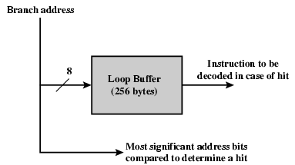
Loop Buffer Diagram

Slide 24
Branch Prediction (1)
Predict never taken
  Assume that jump will not happen
  Always fetch next instruction
  68020 & VAX 11/780
  VAX will not prefetch after branch if a page fault would result (O/S v CPU design)
Predict always taken
  Assume that jump will happen
  Always fetch target instruction
Notes:
45

Slide 25
Branch Prediction (2)
Predict by Opcode
  Some instructions are more likely to result in a jump than thers
  Can get up to 75% success
Taken/Not taken switch
  Based on previous history
  Good for loops
  Refined by two-level or correlation-based branch history
Correlation-based
  In loop-closing branches, history is good predictor
  In more complex structures, branch direction correlates with that of related branches
    Use recent branch history as well
Notes:
46

Slide 26
Branch Prediction (3)
Delayed Branch
  Do not take jump until you have to
  Rearrange instructions
Notes:
47

Slide 27
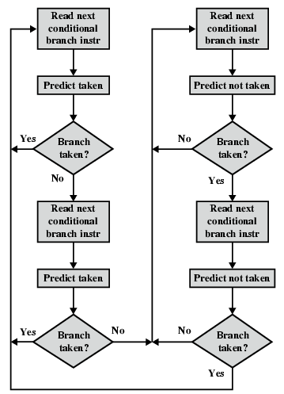
Branch Prediction Flowchart

Slide 28
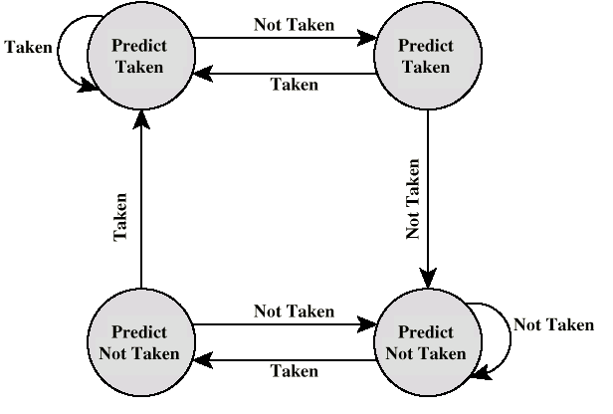
Branch Prediction State Diagram

Slide 29
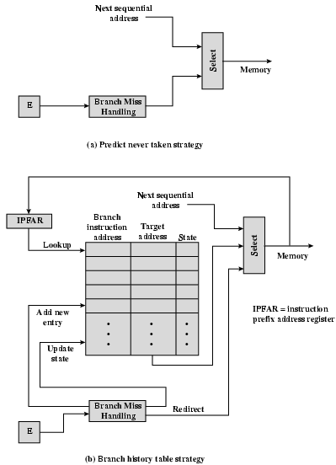
Dealing With
Branches

